Slide 1

Hello Everyone

Slide 2
INTRODUCTION TO INFORMATION ASSURANCE
FINAL PROJECT
Topic
Artificial Intelligence: Implication for Cybersecurity
Dr. Yvonne Kamenge
CHINTHAPALLY MADAN – 700760187
TEJA SAI REDDY JAMMALA – 700758483
BALE SAI NAVEEN – 700759922
DEVARAM SAI KIRAN REDDY – 700758953
NAVYA TALATAM - 700760004
MUCHA RAVITEJA REDDY – 700746130
GANTA NANDU – 700760241

Slide 3
INTRODUCTION TO INFORMATION ASSURANCE
FINAL PROJECT
Topic
Artificial Intelligence: Implication for Cybersecurity
Dr. Yvonne Kamenge
CHINTHAPALLY MADAN – 700760187
TEJA SAI REDDY JAMMALA – 700758483
BALE SAI NAVEEN – 700759922
DEVARAM SAI KIRAN REDDY – 700758953
NAVYA TALATAM - 700760004
MUCHA RAVITEJA REDDY – 700746130
GANTA NANDU – 700760241

Slide 4
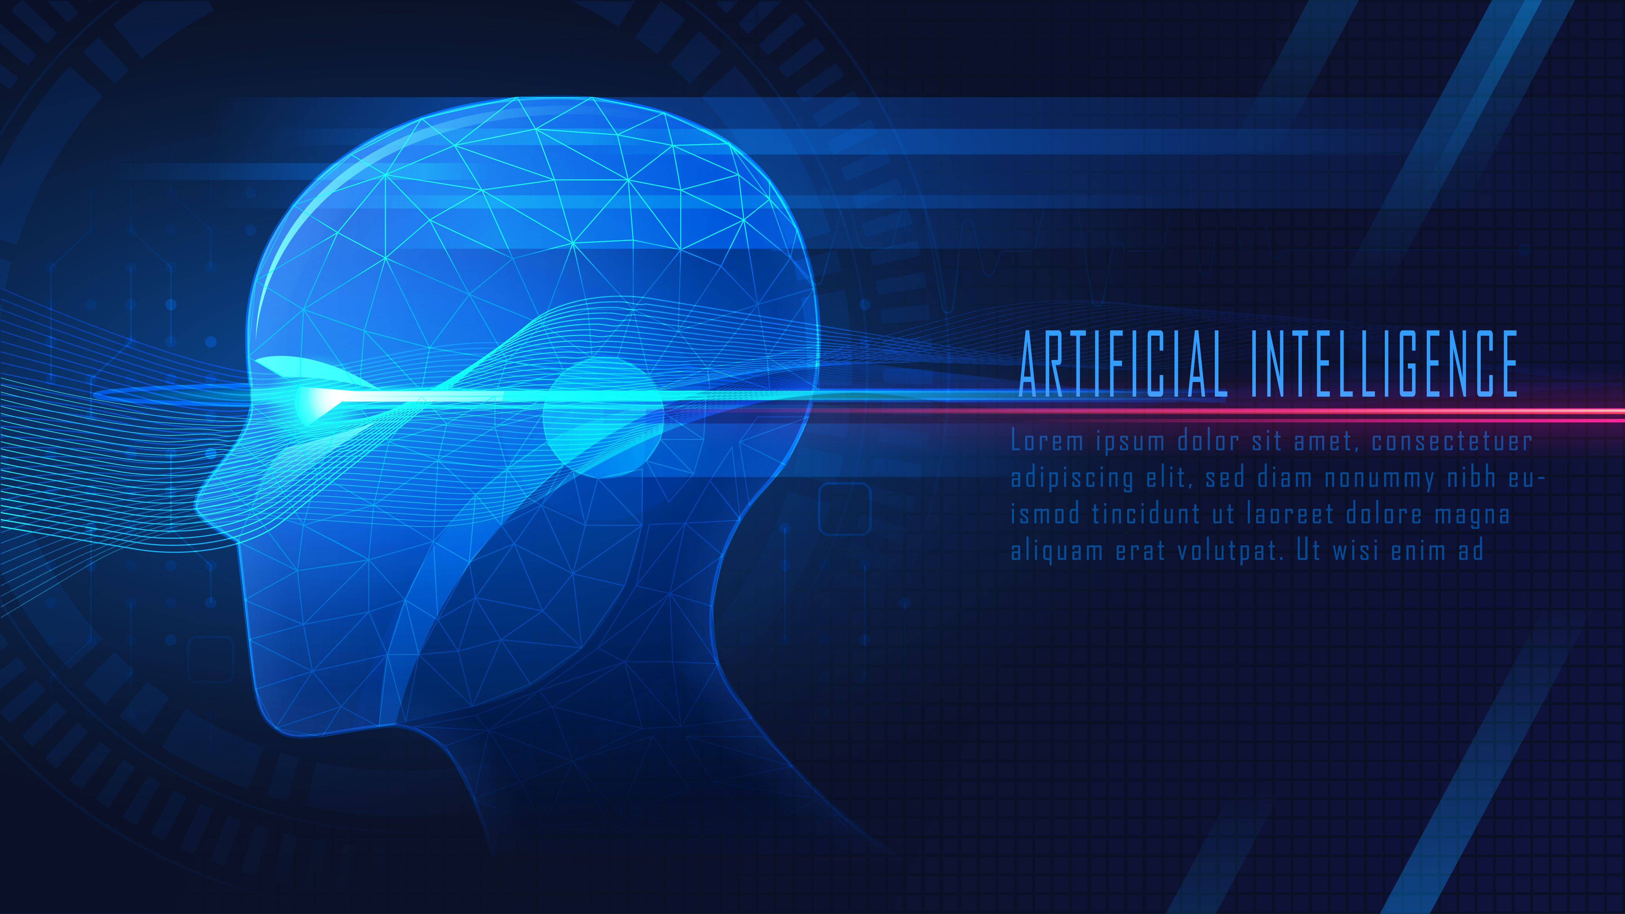
AI is about using problem-solving and learning to imitate human-like decision-making and emotions in complex tasks.

Slide 5
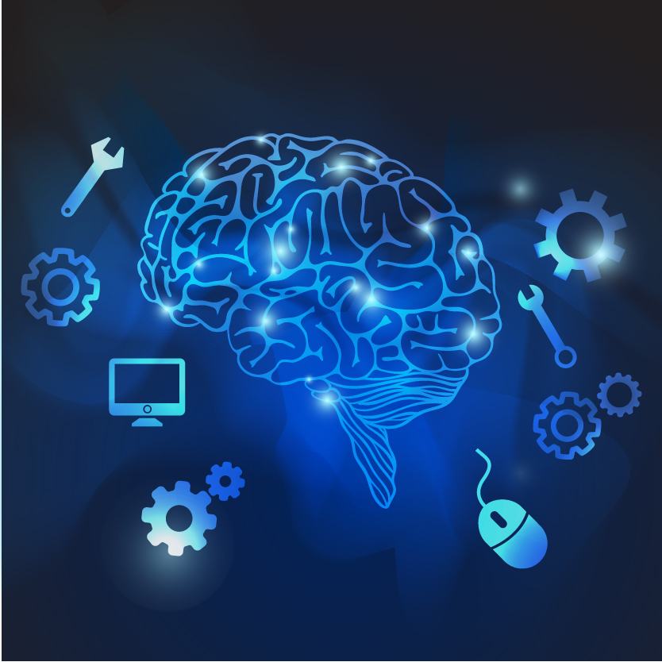
Predictive Analytics
Natural language processing (NLP)
Deep learning and Neural networks
AI Technologies in Cybersecurity

Slide 6
Natural language processing (NLP)
Predictive Analytics
Machine Learning Algorithms
Deep learning and Neural networks

Slide 7
Machine learning is a branch of Artificial Intelligence and computer science that focuses on solving problems for which the program is developed using algorithms by human programmers.
There are 3 types of machine learning that are implemented in cybersecurity
Supervised Learning
Unsupervised Learning
Reinforcement learning

Slide 8
Machine learning is a branch of Artificial Intelligence and computer science that focuses on solving problems for which the program is developed using algorithms by human programmers.
There are 3 types of machine learning that are implemented in cybersecurity
Supervised Learning
Unsupervised Learning
Reinforcement learning

Slide 9
Deep learning and neural networks
Intrusion Detection and Prevention Systems (IDS/IPS)
Intrusion Detection and Prevention Systems (IDS/IPS)

Slide 10
Deep learning and neural networks
In the broader field of artificial intelligence, deep learning is a subtype of machine learning (ML). Artificial neural networks (ANNs), which are used in deep learning, are created to look like and perform similarly to the connectivity and operation of neurons in the human brain.
Intrusion Detection and Prevention Systems (IDS/IPS)
Intrusion Detection and Prevention Systems (IDS/IPS)

Slide 11
Natural language processing (NLP)
NLP uses a variety of statistical models to identify and filter spam by learning common forms of communication and linguistic patterns.
Predictive analytics
Predictive analytics is a way of using data to foresee future events and outcomes, such as customer behavior, market trends, or machine failures.

Slide 12

Intrusion detection and prevention systems (IDPS)
Anomaly detection
Behavioral analytics
Signature-based detection
Threat Detection and Prevention

Slide 13
Intrusion detection and prevention systems (IDPS)
Anomaly detection
Behavioral analytics
Signature-based detection
Threat Detection and Prevention

Slide 14

Vulnerability Assessment and Management
AI in Security Information and Event Management (SIEM)
KEY POINTS
Decrease the need for human expertise
Adversarial Attacks on AI in Cybersecurity
Defending Against AI Exploits
Bias and Fairness in AI

Slide 15
Vulnerability Assessment and Management
AI in Security Information and Event Management (SIEM)
KEY POINTS
Decrease the need for human expertise
Adversarial Attacks on AI in Cybersecurity
Defending Against AI Exploits
Bias and Fairness in AI

Slide 16

The Importance of Ensuring Fairness in AI-Driven Decision-Making
j
Reducing Discriminatory Effects
Better User Adoption and Trust
Successful Risk Assessment
Complying with Regulations

Slide 17

Future Directions in Cybersecurity in AI
Advanced Threat Detection
Behavioral Analytics
Explainable AI (XAI)
Quantum Computing Security
Privacy-Preserving AI
Automated Incident Response
AI in Deception Technologies

Slide 18


Challenges in Cybersecurity in AI
Adversarial Attacks
Data Privacy
Ethical Concerns
Skill Gap
Interoperability
Regulatory Compliance
Mistakes
Resource Intensiveness
Lack of Trust

Slide 19

Conclusion
In conclusion, while AI offers significant potential to enhance cybersecurity, it also presents new challenges. Addressing these challenges and leveraging AI effectively will be essential for organizations to protect against evolving cyber threats and maintain a strong cybersecurity posture.

Slide 20

Thank you shoot your questions

